Slide 1
DayCent’s Grasstree plant production model
Bill Parton and Melannie Hartman
May 13, 2014

Slide 2
Overview of Grasstree submodel
Large perennial grasses such as miscanthus, switch grass, sugar cane
Has features of DayCent’s crop and tree submodels
Grasstree parts (5 live, 2 dead)
  Live and dead attached leaves
  Live and dead standing stems
  Juvenile and mature fine roots
  Coarse roots (rhizhomes)

Slide 3
DayCent Features
Crops/Grasses | Tree | Grass-Tree
shoots | leaves | leaves
juvenile fine roots | juvenile fine roots | juvenile fine roots
mature fine roots | mature fine roots | mature fine roots
 | large wood | -
 | fine branches | New: live stems
 | coarse roots | Rhizomes (coarse roots)
 |  | New: dead leaves (attached)
 |  | New: dead stems (standing)
senescence | no senescence | senescence
phenology can be related to growing degree days | no growing degree day based phenology | phenology can be related to growing degree days (GDD to be added at a later date)
C:N in shoots grows wider as grass matures to simulate increased stem biomass |  | C:N in leaves and stems grows wider as grass matures to simulate increased stem biomass
 |  | Self Shading, leaf death
 |  | extended water stress
 |  | low temperatures (shoot death)

Slide 4
Perennial GrassTree: Non-Growing Degree Day option
gtfrtcindx = 1
Read grasstree.100
file for grasstree type
GRAS
GFST
SENM
GLST
TREM
GFST event
determines
start of growth
No frost kill
for non-GDD
SENM event
triggers senescence
(death)
GLST: Plant death
occurs if not
already triggered
from SENM
TREM indicates
a harvest event
Notes:
Grasstrees are perennials, there are no annuals.
The growing degree day option (gtfrtindx=3) is not yet available.
Grasstrees can not be grown in same schedule file block as crops/grasses (crop.100) or trees (tree.100)
These schedule file options are available in grasstree schedule file block
(although many have not been tested yet)
GRAS, GFST, GLST, CULT, FERT, FIRE, IRRI, OMAD, SENM, TREM
These schedule file options are NOT available in grasstree schedule file block:
CROP, PLTM, LAST, FRST, TREE, TFST, TLST, GRAZ, HARV

Slide 5
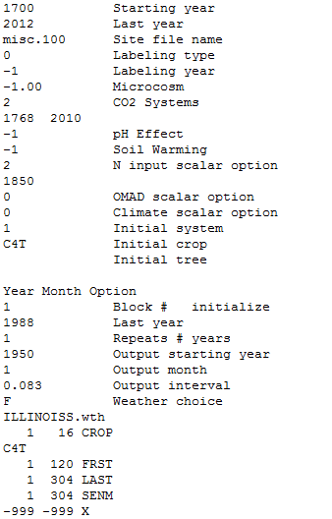
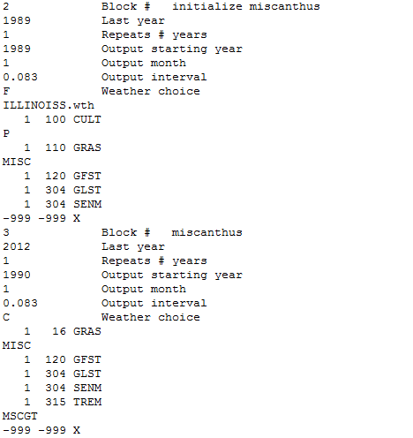
Example Schedule File using GRAS, GFST, GLST, TREM
New CO₂ option (2),
read from co2conc.dat
read MISC parameters
from grasstree.100
Initial system
1: crop/grass
2: forest
3: savanna
4: grasstree
Harvest::
read MSCGT parameters from trem.100

Slide 6
Harvest
Uses trem.100 parameters to specify harvest options (as for trees)
Parameter definitions in grasstree context:
  EVNTYP – 0 for cutting, windstorm, of other non-fire; 1 for fire.
  REMF(1) – fraction of material component removed from live and attached dead leaves
  REMF(2) – fraction of material component removed from live and standing dead stems
  REMF(3), REMF(4), REMF(5) – not used
  FD(1) – fraction of fine roots that die
  FD(2) – fraction of coarse roots that die
  RETF(1,1-4) – fraction of C, N, P, and S in killed live and dead attached leaves that is returned to the system as ash or litter
  RETF(2,1-4) – fraction of C, N, P, and S in killed live and dead standing stems that is returned to the system as ash or litter
  RETF(3,1-4) – not used
Output variables (use list100):
  gtcrem = C removed from harvest of live and dead leaves and live and dead stems (gC m⁻²)
  gterem(1) = N removed from harvest of live and dead leaves and live and dead stems (gN m⁻²)
  gterem(2) = P removed from harvest of live and dead leaves and live and dead stems (gP m⁻²)
  gterem(3) = S removed from harvest of live and dead leaves and live and dead stems (gS m⁻²)

Slide 8
Results
Live Leaf C
Live Stem C
Coarse Root C
Juvenile Fine Root C
Mature Fine Root C
Coarse Root C

Slide 9
Results, cont’d
NPP is ~50%
of GPP

Slide 10
Results, cont’d
leaves
stems
juvenile fine roots
mature fine roots
coarse roots

Slide 11
Results, cont’d
Harvested
C and N

